Slide 1
Data Flow Computer
Module 4
Non von Neumann architectures
Ref:Hwang Chapter 2 and
Hwang and Briggs Chapter 10 (page734/softcopy page 753) to page743/softcopy762

Slide 2
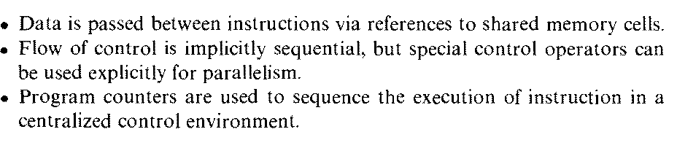
Sequential or Parallel Control Flow
Characteristic Features:
(fort ,join statements used to create parallel process)

Slide 3
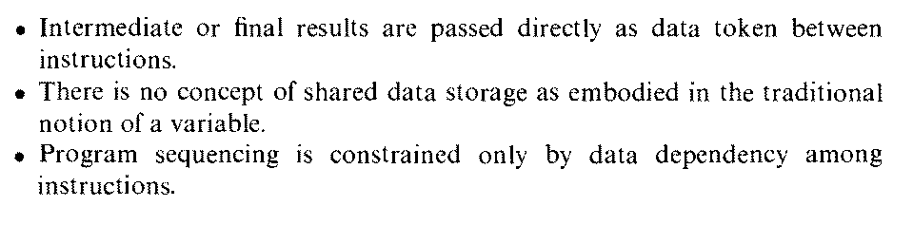
Data Flow Model
Characteristic Features:
Note:
No Program Counter
In data flow computers the machine level program is represented by data flow graphs
Firing rule of instructions is based on data availability

Slide 4
Data Flow Execution Sequence shown by Data Flow Graph
X=3
Y= 6
Z= (x+y) * 2
+
2
*
Z

Slide 5
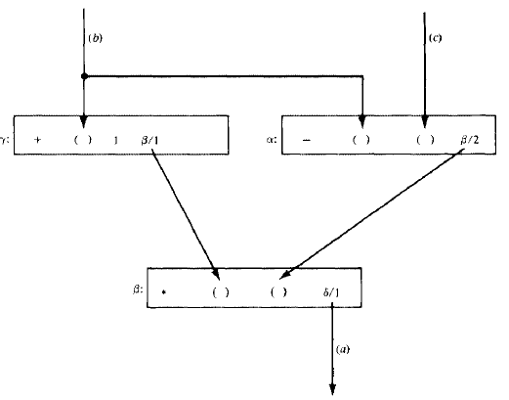
Data Flow Computers

Slide 6
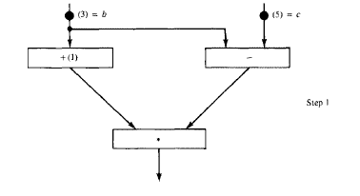
Data Flow Computation

Slide 7
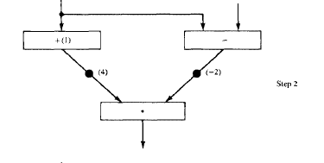
Data Flow Computation

Slide 8
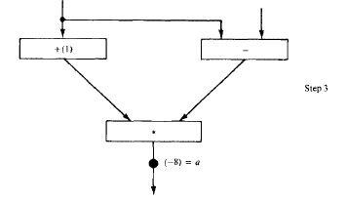
Data Flow Computation

Slide 9
To Execute a Program in
Data Flow Computer
Program is analyzed to find the dependencies among data in the program
Program analysis can be represented by data flow graphs

Slide 10
What is Data Flow Graph?
A directed graph whose nodes correspond to operators and arcs are pointers for forwarding data tokens
The graph demonstrates sequencing constraints (data dependencies) among instructions

Slide 11
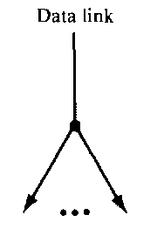
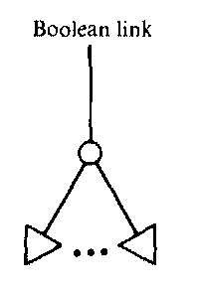
Data Flow Graph Symbols
Transmit integer , real , complex numbers
Carries only Boolean value for control purposes

Slide 12
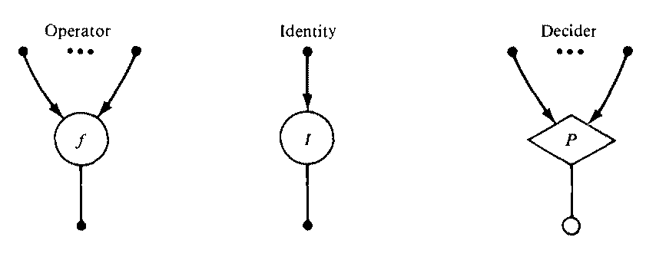
Data Flow Graph Symbols
Operation Value goes through A value for each input arc produces the truth value applying the predicate P to values
received

Slide 13
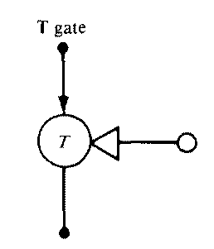
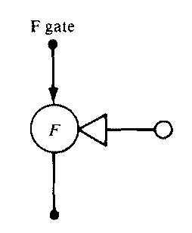
Data Flow Graph Symbols
Used for conditional computation or iterative computation
T gate passes a data token from its input arc to its output arc if it receives a Control token with “true” Boolean value
F gate passes data token on if “false” control token is received

Slide 14
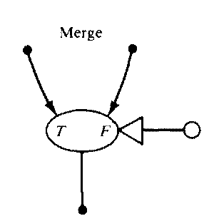
Data Flow Graph Symbols
When control value is true the input token of the true arc is transmitted
When control value is false the input token of the false arc is transmitted

Slide 15
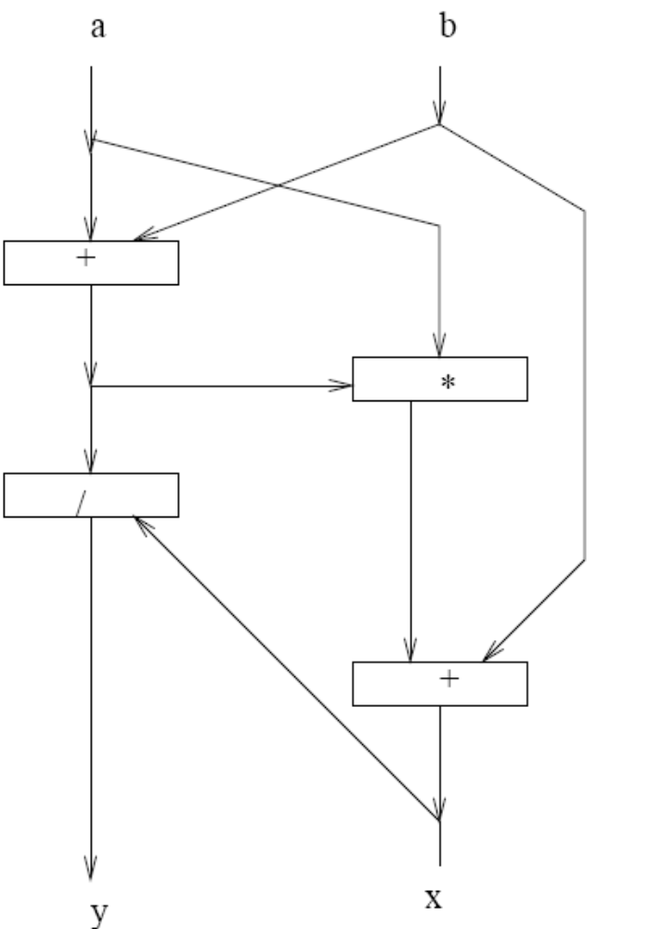
Example:
input a,b
    y := (a+b)/x
x := (a*(a+b))+b
output y,x
note ordering of statements in program is irrelevant
(C) 2007 J. E. Smith ECE/CS 757

Slide 16
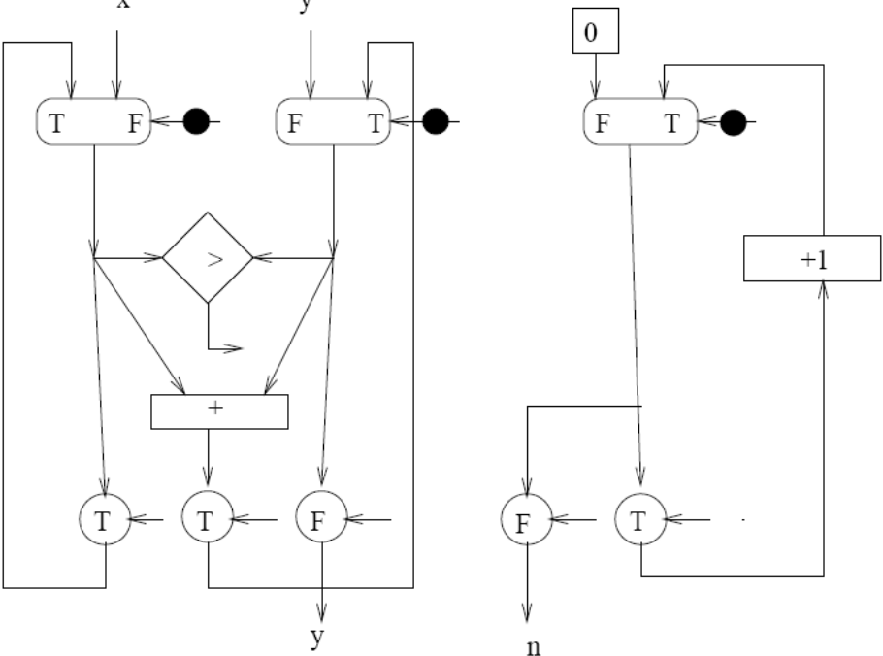
Loop Example
input y,x
n := 0
while y<x do
y := y + x
n := n + 1
end
output y,n
(Using arrays was intentionally avoided)
(C) 2007 J. E. Smith ECE/CS 757

Slide 17
Assignment
Represent by data flow graph using the symbols described in previous slides the sequence of following computations:
  if (x > 3)
  y=x + 2
  else
  y = x – 1
  y= y * 4
  while (x > 0) do
  x=x-3
  3) fact = 1
  while ( n > 0){ fact = fact *n;
  n= n – 1; } o/p fact

Slide 18
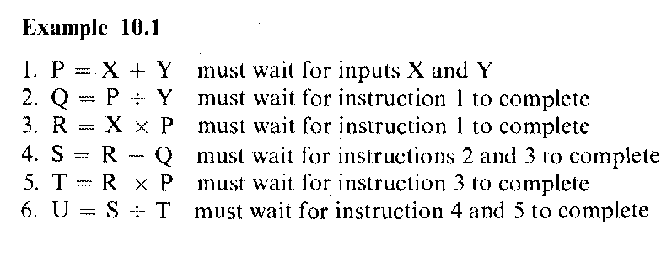
Assignment contd…
Represent by data flow graph the sequence of following computations:
(Hwang and Briggs Softcopy page 759-760)
4)

Slide 19
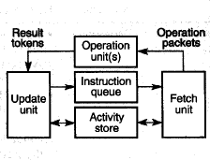
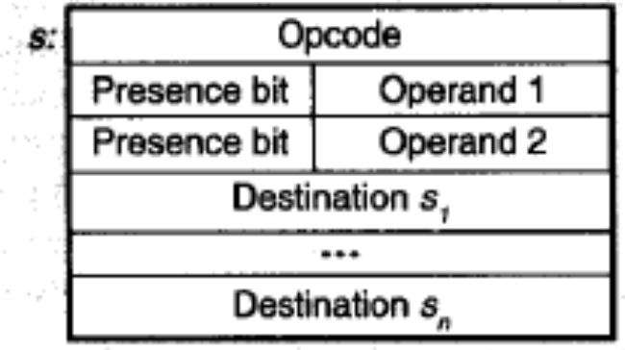
Static Dataflow
Combine control and data into a template
  like a reservation station
  except they are held in memory
  can inhibit parallelism among loop iterations
  re-use of template ⇒ acks
(C) 2007 J. E. Smith ECE/CS 757

Slide 20
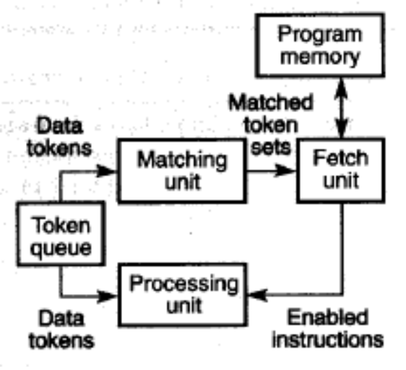
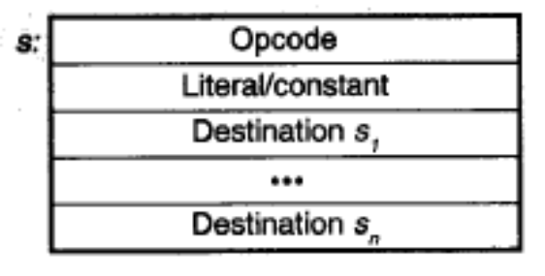
Dynamic Dataflow
Separate data tokens and control
  Token: labeled packet of information
Allows multiple iterations to be simultaneously active
  shared control (instruction)
  separate data tokens
  A data token can carry a loop iteration number
Match tokens’ tags in matching store via assoc. search
  if match not found, make entry, wait for partner
When there is a match, fetch corresponding instruction from program memory
Requires large associative search
  to match tags
Adds “structure storage”
  access via select function – index and structure descriptor as inputs
(C) 2007 J. E. Smith ECE/CS 757

Slide 21
Dataflow: Advantages/Disadvantages
Advantages:
  no program counter
    data-driven
    execution inhibited only by true data dependences
  stateless / side-effect free
    further enhances parallelism
Disadvantages
  no program counter
    leads to very long fetch/execute latency
    spatial locality in i-fetch hard to exploit
    requires matching (e.g., via associative compares)
  stateless / side-effect free
    no shared data structures
    no pointers into data structures (implies state)
    In theory take entire data structure as input “token” and emit a new version
  I/O difficult – depends on state
    Virtual memory??
(C) 2007 J. E. Smith ECE/CS 757

Slide 22
A global version of Tomasulo's algorithm
  (Tomasulo's alg came first)

